Slide 1
Software Models
Process Models
The Unified Process

Slide 2
Process Models (Prescriptive Models / Prescriptive Process Model)
What is it?
Process models define a distinct set of activities, actions, tasks, milestones and work products that are required to engineer high-quality software.
Who does it?
Software engineers and their managers adopt a process model to their needs and then follow it.
Why is it important?
Because it provides stability, control and organization to an activity.

Slide 3
Prescriptive Models
“There are many ways of going forward, but only one way of standing still”
Today more prescriptive software development models exist.
A software engineer have to choose one model for his work.
Each prescriptive model can accommodate generic process framework that encompasses communication, planning, modeling, construction and deployment.

Slide 4
Why the model is called prescriptive?
The model prescribes a set of process elements – software engineering actions, tasks, work products, quality assurance, and change control mechanisms for each project.
Each model prescribes a workflow.
Though generic process framework is the major idea behind, each model applies a different style to those activities and defines a workflow.
Communication -> Planning -> Modeling -> Construction -> Deployment

Slide 5
The Waterfall Model
Sometimes called the classic life cycle, suggests a systematic sequential approach to software development that begins with customer requirements and progress through Communication -> Planning -> Modeling -> Construction -> Deployment.
It is a successful and oldest model for software engineering. However criticism on this process model has caused even supporters to question its efficacy.

Slide 6
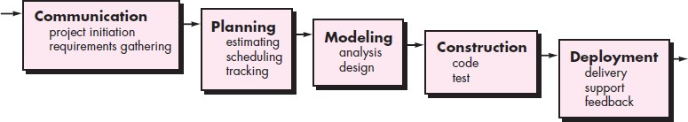
The Waterfall Model
Although the original waterfall model proposed by Winston Royce made provision for “feedback loops,” the vast majority of organizations that apply this process model treat it as if it were strictly linear.

Slide 7
Problems in the Waterfall Model
Real projects rarely follow the sequential flow that the model proposes. Although the linear model can accommodate iteration, it does so indirectly. As a result, changes can cause confusion as the project team proceeds.
It is often difficult for the customer to state all requirements explicitly. The waterfall model requires this and has difficulty accommodating the natural uncertainty that exists at the beginning of many projects.
The customer must have patience. A working version of the program(s) will
not be available until late in the project time span. A major blunder, if undetected until the working program is reviewed, can be disastrous.

Slide 8
A variation in the Waterfall Model (V-Model)
A variation in the representation of the waterfall model is called the V-model.
V-model depicts the relationship of quality assurance actions to the actions associated with communication, modeling, and early construction activities.

Slide 9
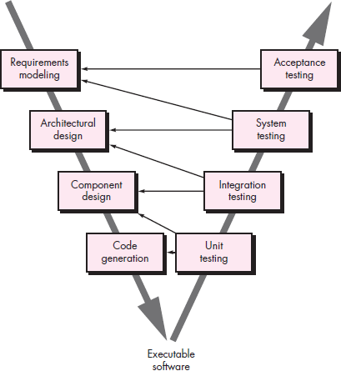

Slide 10
A variation in the Waterfall Model (V-Model)
As a software team moves down the left side of the V, basic
and
problem technical
requirements are refined into progressively more detailed
representations of the problem and its solution.
Once code has been generated, the team moves up the right side of the V, essentially performing a series of tests (quality assurance actions) that validate each of the models created as the team moved down the left side.
In reality, there is no fundamental difference between the classic life cycle and the V-model. The V-model provides a way of visualizing how verification and validation actions are applied to earlier engineering work.

Slide 11
Incremental Process Model
Consider the following two connected scenarios:
There are many situations in which initial software requirements are reasonably well defined, but the overall scope of the development effort precludes (prevent from happening; make impossible) a purely linear process.
There may be a compelling need to provide a limited set of software functionality to users quickly and then refine and expand on that functionality in later software releases.
In such cases, you can choose a process model that is designed to produce the software in increments.

Slide 12
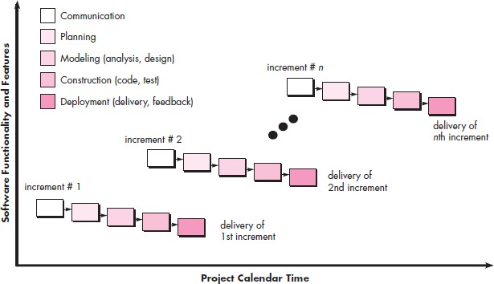
Incremental Process Model

Slide 13
Concepts behind Incremental Process Model
The incremental model combines elements of linear and parallel process flows.
The incremental model applies linear sequences in a staggered (walk or move unsteadily) fashion as calendar time progresses.
Each linear sequence produces deliverable “increments” of the software.
For example, word-processing software developed using the incremental paradigm might deliver basic file management, editing, and document production functions in the first increment; more sophisticated editing and document production capabilities in the second increment; spelling and grammar checking in the third increment; and advanced page layout capability in the fourth increment.

Slide 14
Concepts behind Incremental Process Model
When an incremental model is used, the first increment is often a core product.
That is, basic requirements are addressed but many supplementary features (some known, others unknown) remain undelivered.
The core product is used by the customer (or undergoes detailed evaluation). As a result of use and/or evaluation, a plan is developed for the next increment.
The plan addresses the modification of the core product to better meet the needs of the customer and the delivery of additional features and functionality.

Slide 15
Advantages of Incremental Process Model
Useful when staffing is unavailable for a complete implementation by the business deadline that has been established for the project. Early increments can be implemented with fewer people.
If the core product is well received, then additional staff (if required) can be added to implement the next increment.
In addition, increments can be planned to manage technical risks. For example, a major system might require the availability of new hardware that is under development and whose delivery date is uncertain. It might be possible to plan early increments in a way that avoids the use of this hardware, thereby enabling partial functionality to be delivered to end users without inordinate delay.

Slide 16
The RAD Model
It is an incremental process model that emphasizes a short development cycle.
It is a high speed adoption of the waterfall model, in which rapid software development is achieved by using a component based development.
If customer requirements are full understood and project scope is constrained, the RAD process enables a development team to create a “fully functional system” within a very short period of time. (Ex:- 60 to 90 days)

Slide 17
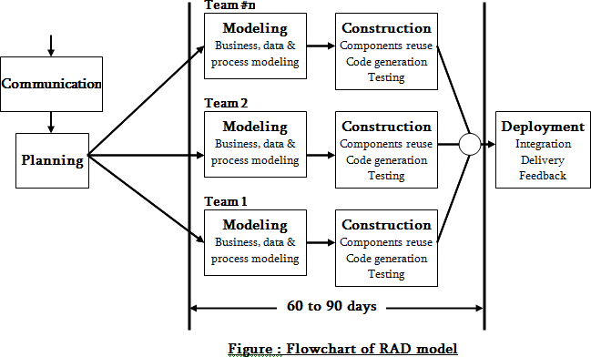

Slide 18
The RAD Model
Like other process models, RAD model maps into process framework activities.
Communication & Planning: helps to understand business problem and information characteristics that the software must accommodate.
Modeling: It encompasses three major phases:
Business modeling
Data modelling
Process modeling
Construction: emphasizes the use of pre-developed software components and automatic code generation.
Deployment: initiates subsequent iteration.

Slide 19
Five Drawbacks of RAD Model
For large and scalable projects (continuous development) RAD model requires more human resources to create more number of teams.
If developers and customers are not committed to the rapid-activities that are necessary to complete the system within a short-time, the entire system will fail.
If a system cannot be properly modularized, the RAD will be problematic.
RAD may not be suitable if technical risks are high.
If performance is an issue, and high performance can be achieved through tuning the interfaces among components, the RAD is useless.

Slide 20
Evolutionary Process Models
Evolutionary process models are iterative. They are highly useful to a software engineer to develop more complex version soft wares.
Three types in evolutionary process model:
The prototyping model
The spiral model
The concurrent development model

Slide 21
The prototyping model
Consider the following two different situations:
Often, a customer defines a set of general objectives, but does not identify a detailed specifications like input, processing and output requirements. Its a problem in customer side.
Next is, problems in developer side; a developer may unsure about the efficiency of an algorithm; the adoptability of an operating system; problems in human-computer interaction etc.
In these non-stabilized cases, the prototyping model may offer a best solution.

Slide 22
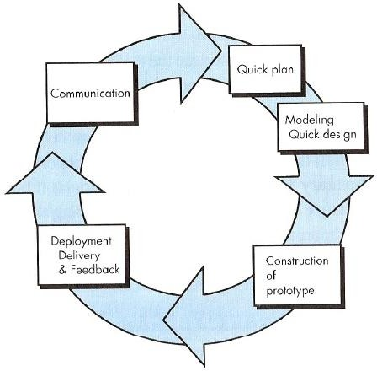
The prototyping model

Slide 23
Problems in prototyping model
Customer gets disappointed and lodge more complaints about the product after seeing an initial version of working model, because they see a temporary patch. The customer sees what appears to be a working version of the software, unaware about the prototype. When a developer informed that the product must be rebuilt so that high quality can be maintained, the customer demands that “a few fixes” be applied to make the prototype a working product.
The developer makes implementation compromises in order to get a working prototype. An inappropriate program / inefficient algorithm / easy tool may be used to demonstrate the capability of working model. Later, the developer become comfortable with these choices and forget all the reasons why they were inappropriate. The less-than-ideal choice has now become an integral part of the system.

Slide 24
The Spiral model
It’s a hybrid model that couples the iterative nature of prototyping model and controlled and systematic aspect of waterfall model.
It provides potential for rapid development of more complex versions of software. It is a part evolutionary model.
A spiral model is divided into a set of framework activities. Each framework activity represents one segment of the spiral path.

Slide 25
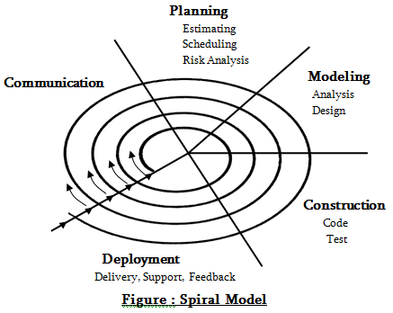

Slide 26
The Spiral model
As this process begins, the software team performs activities that are implied by a circuit around the spiral in a clockwise direction, beginning at the center.
Anchor path milestones – a combination of work products and conditions are attained along the path of spiral.

Slide 27
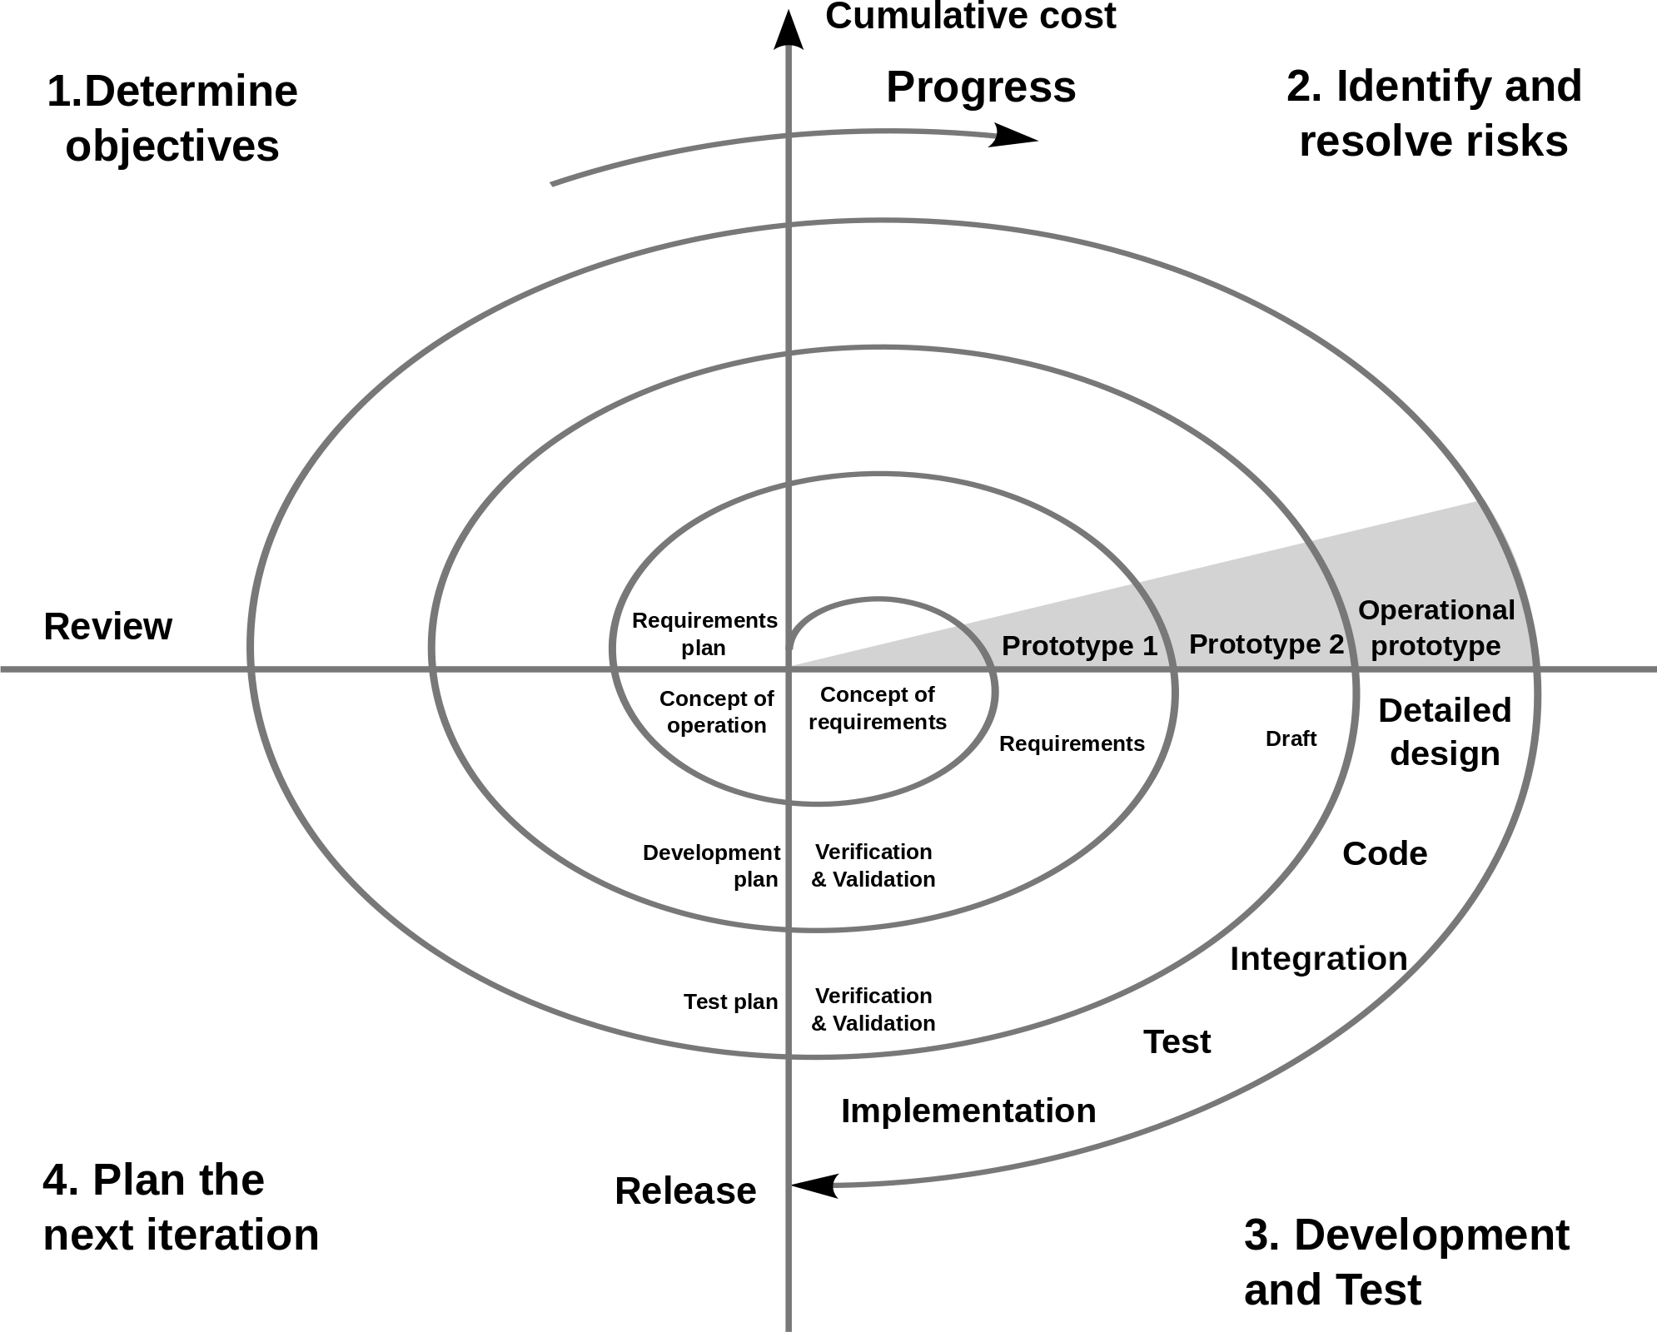

Slide 28
The positives and negatives of Spiral model
Positives are: The spiral model is a realistic approach to the development of large- complex systems.
It helps developer to understand and react to the risks at each evolutionary levels.
It sees prototype as one of risk reducing mechanism, and it enables the developer to use prototyping approach at every evolutionary levels.
Problems are: It is very difficult to convince a customer (particularly in contract situations) that the model is controllable.
It demands risk assessment expertise and relies on this expertise on success. If a major risk is uncovered, problems will occur.

Slide 29
The concurrent development model
Sometimes called concurrent engineering, can be represented schematically as a series of framework activities, software engineering actions, tasks and their associated states.
The model defines a series of events that will trigger transitions from state to state for each of the software engineering activities, actions, or tasks.

Slide 30
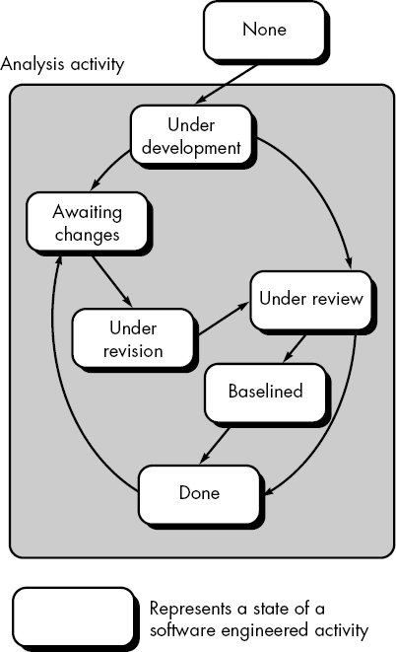

Slide 31
The concurrent development model
Consider analysis activity – an action may goes on anyone of the given states.
Similarly other activities or tasks can be represented in an analogous (meaning: comparable in certain respects) manner. For your consideration, a modeling activity is given in next slide.

Slide 32
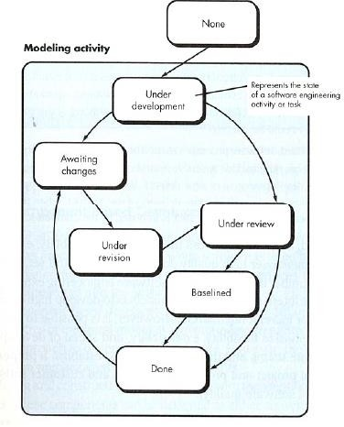

Slide 33
Importance of concurrent development model
The concurrent development model is applicable to all types of software development and provides an accurate picture of the current state of a project.
It defines a network activity, not like other software engineering actions.
Each activity, actions, tasks on the network exists simultaneously with other activities, actions, tasks.

Slide 34
Specialized Process model
Special process models take many features from one or more conventional models. However these special models tend to be applied when a narrowly defined software engineering approach is chosen.
Types in Specialized process models:
Component based development (Promotes reusable components)
The formal methods model (Mathematical formal methods are backbone here)
Aspect oriented software development (Uses crosscutting technology)

Slide 35
Component based development
The component based development model incorporates many of the characteristics of the spiral model. It is evolutionary in nature, demanding an iterative approach to the creation of software.
However, the model focuses on prepackaged software components. It promotes software reusability.

Slide 36
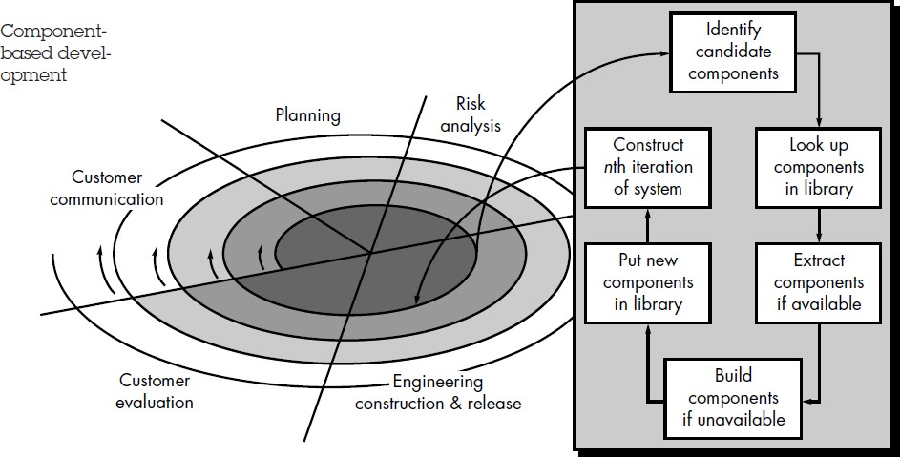
Component based development

Slide 37
Component based development
Modeling and construction activities begin with the identification of candidate components. Candidate components can be designed as either conventional software modules or object oriented packages.
Component based development has the following steps:
Available component based products are researched and evaluated for the application domain.
Component integration issues are considered.
A software architecture is designed to accommodate the components.
Components are integrated into the architecture.
Comprehensive testing is conducted to ensure proper functionality.

Slide 38
Problems in Component based development
Component trustworthiness - how can a component with no available source code be trusted?
Component certification - who will certify the quality of components?
Requirements trade-offs - how do we do trade-off analysis between the features of one component and another?

Slide 39
The formal methods model
The formal methods model encompasses a set of activities that leads to formal mathematical specification of software. Formal methods enable a software engineer to specify, develop and verify a computer system by applying rigorous mathematical notation.
When mathematical methods are used during software development, they provide a mechanism for eliminating many of the problems that are difficult to overcome using other software engineering paradigms.
Formal methods provide a basis for software verification and therefore enable software engineer to discover and correct errors that might otherwise go undetected.

Slide 40
Problems in formal methods model
The development of formal models is currently time-consuming and expensive.
Because few developers have the necessary background knowledge to apply formal methods, extensive training is required to others.
It is difficult to use this model as a communication mechanism for technically unsophisticated people.

Slide 41
Aspect oriented Software Development
Aspect Oriented Software Development (AOSD) often referred to as aspect- oriented programming (AOP), a relatively new paradigm that provides process and methodology for defining, specifying designing and constructing aspects.
It addresses limitations inherent in other approaches, including object-oriented programming. AOSD aims to address crosscutting concerns by providing means for systematic identification, separation, representation and composition.
This results in better support for modularization hence reducing development, maintenance and evolution costs.

Slide 42
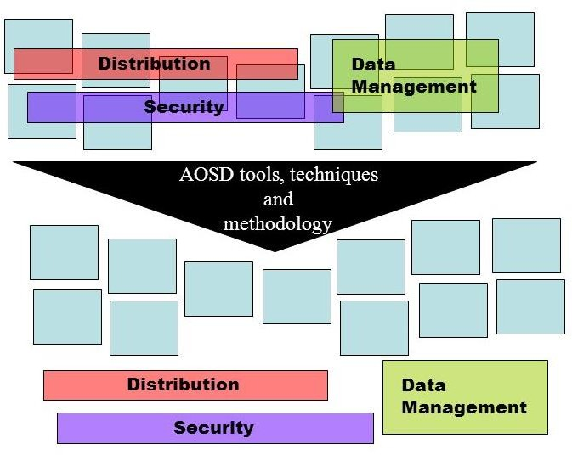
.

Slide 43
The Unified Process
What is it?
The Unified Process (UP) is an attempt to draw on the best features and characteristics of conventional software process models, but characterize them in a way that implements many of the best principles of agile software development.
The Unified Process recognizes the importance of customer communication and streamlined methods for describing the customer’s view of a system.
It helps the architect to focus on the right goals, such as understandability, reliance to future changes, and reuse.

Slide 44
Agile Software Development
What is agile software development?
“Agile Development” is an umbrella term for several iterative and incremental software development methodologies. The most popular agile methodologies include Extreme Programming (XP), Scrum, Crystal Clear, Dynamic Systems Development Method (DSDM), and Feature-Driven Development (FDD).
Agile Manifesto:
We are uncovering better ways of developing software by doing it and helping others do it. Through this work we have come to value:
Individuals and interactions over processes and tools
Working software over comprehensive documentation Customer collaboration over contract negotiation Responding to change over following a plan

Slide 45
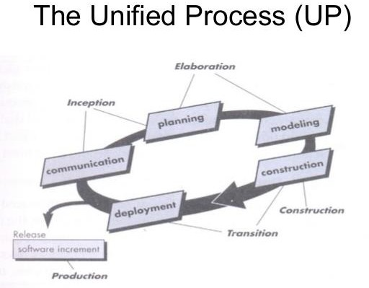

Slide 46
Phases of the Unified Process
Inception phase: encompasses both customer communication and planning activities.
Elaboration phase: encompasses planning and modeling activities. Construction phase: is identical to the construction activity.
Transition phase: encompasses latter stages of construction activity and first part of the generic deployment activity.
Production phase: coincides with the deployment activity of the generic process.

Slide 47
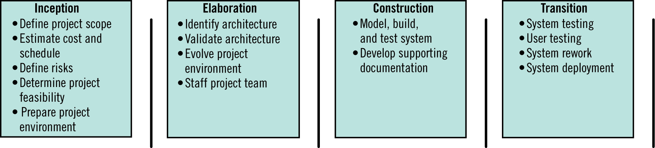
Major Workflow Produced for Unified Process

